Slide 1

Dams of Jordan Social Cohesion and Area Mapping Report
Presentation of findings for Wala Dam, Wadi Al Arab Dam, King Tala Dam, Tannour Dam, and Zeglab Dam
July 2019

Slide 2
Methodology

Slide 3

Methodology
Project Objective: To provide community mapping and analysis of the five dam areas, and one UNESCO site, in order to inform GIZ-funded livelihoods programming, including identifying the potential sources of challenges to social cohesion presented by the implementation of cash for work projects in targeted areas.
Key Informant Interviews (KIIs)
Focus group discussions (FGDs)
Household surveys of sample size 380 – 400, 95% confidence level, 5% precision
Stratification by community
Notes:
All studies included a quantitative and a qualitative component
First 2 – 5 key informant interviews were contacted determine the sampling area around the dam. Some information about community dynamics and land ownership.
3 – 6 FGDs conducted (depending on the number of communities). Purpose to understand the social dynamics and community perceptions of key stakeholders, ideally including Syrian refugees. Participatory mapping component used to understand community perceptions of land ownership and control around the dam. Purposive sampling used to find the FGD participants.
A quantitative survey was conducted with randomly selected households within the sample area. A total of 380-400 households were included in each study, to achieve results generable to the sample area population with a 95% confidence level and 5% margin of error. Sampling was conducted by a random GIS sampling approach. Using OpenStreetMap, REACH enumerators conducted the interview with the household nearest the GPS point.
Add sampling methodology – including a quanti

Slide 4
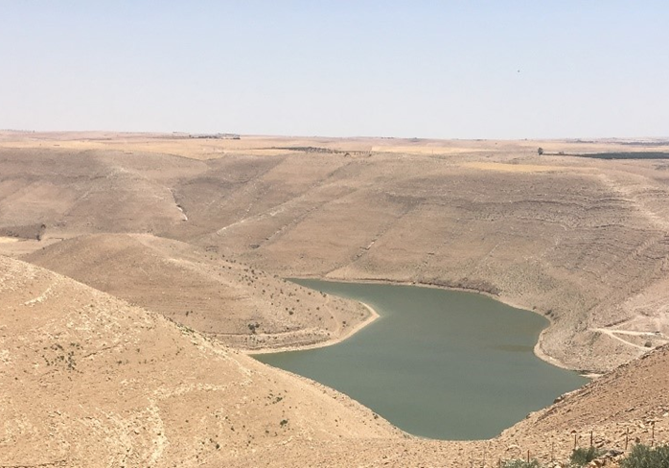
Wadi Wala Dam

Slide 5
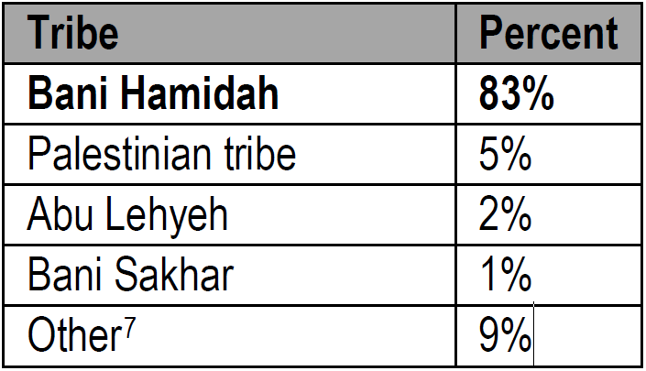
Demographics and socioeconomic background
97% of the population are Jordanian, with just 2% Syrian
82% have at least one employed male member, 21% employed female member
Livelihoods is key household priority identified (48%)
83% of households are in the Bani Hamidah
FGD – residents do accepted daily work
Notes:
Majority of the 392 households were male-headed, and married. They have lived in the area for an average of 28 years.
The majority (82%) of households have at least one male family member who is employed. The top three sectors of employment include the military (40%), other public sector employment (19%), and farming or agricultural work (11%).
Access to livelihoods constitutes a main concern for households in the assessed area as 48% identified it as a priority need followed by education (23%), and health (17%).
FGD participants in Dieban reported that around four years ago the Youth Movement started holding unemployment protests in the area. Since this time, there has been an increasing tension between the community and the government over unemployment and a lack of livelihood opportunities, especially among the youth.
During FGDs, Jordanian participants explained that although they do not prefer daily work, they accept such opportunities because there is a great need for livelihood opportunities. Syrian FGD participants noted that daily work is most common type available for them.
During FGDs, Jordanian participants explained that although they do not prefer daily work, they accept such opportunities because there is a great need for livelihood opportunities.

Slide 6
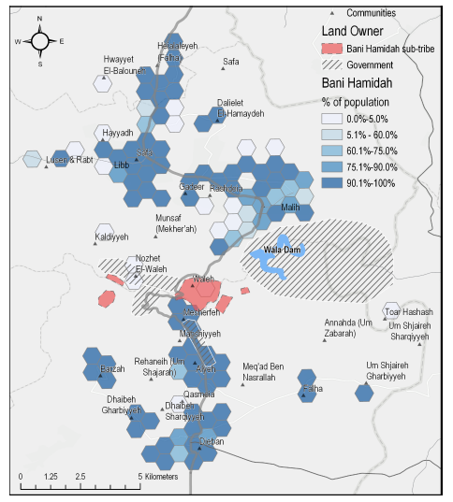
Key Stakeholders
KIs – the land surrounding the dam is owned by a mix of government and private entities
FGD findings– land owned by private owners from Bani Hamidah tribe
HHS - Respondents reported a high level of trust in tribal leaders
HHS - Households resort to tribal leaders and immediate family in cases of inter-community tension

Slide 7
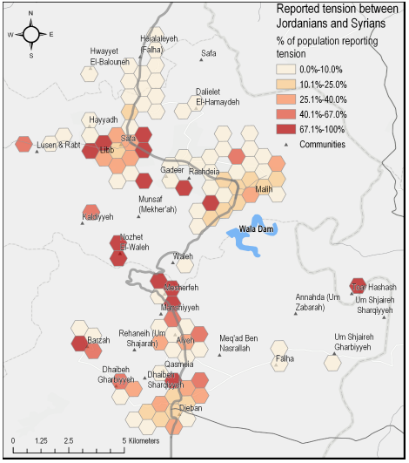
Community Dynamics
Despite small Syrian population, a quarter of households interact with Syrians weekly
30% of households report that they ‘distrust’ or ‘very much distrust’ Syrian refugees
Most common reasons for distrust are competition for jobs (64%), increase in prices (52%), and competition of access to assistance (35%)

Slide 8
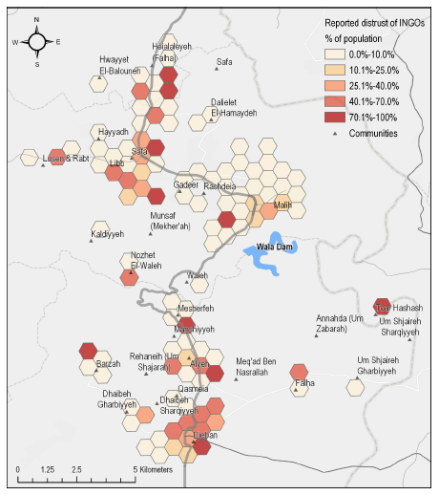
CFW Potential Challenges
Due to limited interactions, majority of households do not know if they trust NGO’s
FGD participants were accepting of CFW activities
FGD participants - bringing members of tribes outside of Bani Hamidah (or other local tribes) for a CFW program would cause inter-tribal tension
Not comfortable with Syrian supervisors

Slide 9
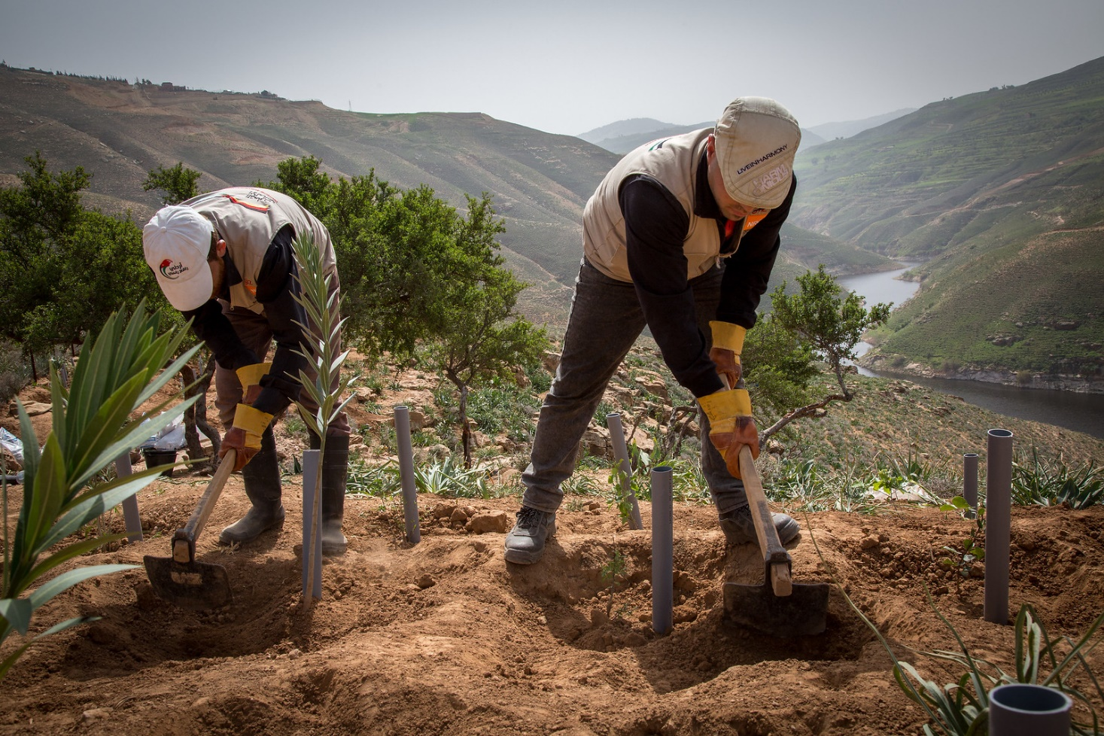
King Talal Dam

Slide 10
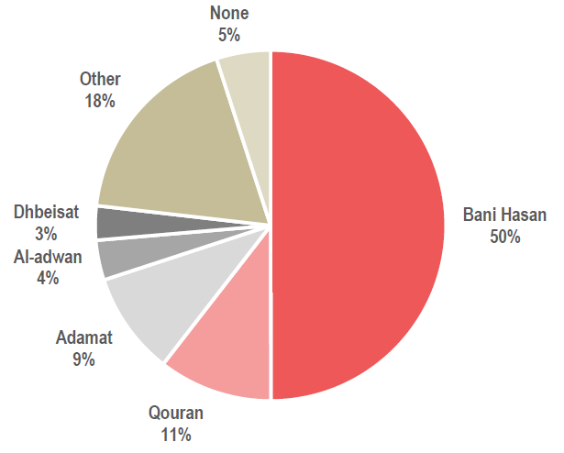
Demographics and socioeconomic background
95 % Jordanian, small Egyptian (3%) and Syrian (2%) minorities
Head of households are relatively educated, majority secondary education (55%) and some postgraduate (17%)
Majority have an employed male family member (84%)
Access to livelihoods main household concern (47%)
Tribally mixed. Bani Hasan largest, but dispersed
Notes:
All of this information based on the household survey. In total, 380 surveys were conducted with households around King Talal dam.
The majority of household heads in the communities around the dam are male-headed (84%) and married (86%).
Heads of households in the communities surrounding the dam are relatively well-educated, with the majority educated to secondary education level (55%) and 17% to a postgraduate level (see Figure 1 below). There are no significant differences in education attainment levels between male and female heads of household in the area.
According to KIIs and FGDs participants, there are over 45 tribes and sub-tribes in the King Talal dam area, dispersed throughout different communities, rather than being geographically concentrated together. The largest tribe is Bani Hasan (50%). According to FGD participants, Bani Hasan is also the wealthiest tribe due to their large number of livestock (a local indicator of wealth).
The majority of households in the King Talal Dam area have at least one male family member who is employed (84%).5 Of these, the majority (73%) rely on just one working member, while 27% have two or more working household members. The top three sectors of employment for male community members are the military (43%), other public sector employment (12%) and agriculture (10%) . Female employment is low (15% of HHs)
Access to livelihoods constitutes a main concern for households in the assessed area with 47% identifying livelihoods as a priority need, followed by public transport (18%), and education (17%).

Slide 11
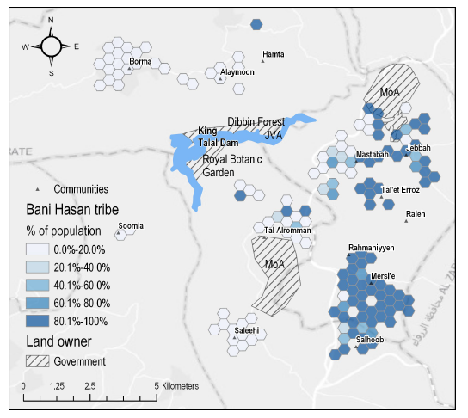
Key Stakeholders
KIs and FGDs found that the land around the dam is owned by the government and some private individuals
Tribal leaders and the Department of Land viewed as the most effective actors in resolving land disputes.
Investments - private farms, villas, pickling factory, beekeeping
High level of trust in tribal leaders, but relatively less interaction
Notes:
According to KIs and FGD participants, land around King Talal dam is officially under the ownership of both the government and some private individuals. Key government stakeholders identified include the JVA and the Ministry of Agriculture (MoA). The Ministry of Water and Irrigation and its dam management department, and the Botanical Garden authority are also reported to have control over parts of the dam area and land use.
Particularly to the south of the dam, south also of the botanical garden, much of the land is owned by private individuals. Due to clear delineation of ownership, the boundaries of land ownership were found to be undisputed and there were no reports of prior tensions or issues around land ownership.
KIs and FGD participants reported that the land to the north of Tal Alrumman has many private farms and villas. Investments include a pickling factory and bee-keeping farms. These investors are from outside the area.
The majority of households who interact with tribal leaders at least once a month do so through direct visits (72%), personal relations (18%), or general meetings (6%). Clearly then, direct personal relationships are important informal mechanisms for communication between community actors.
Although many households do not interact regularly with different community leaders, the majority still either ‘trust’ or ‘trust very much’ these actors (see Figure 6).

Slide 12
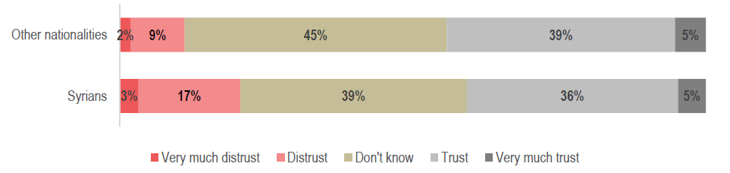
Community Dynamics
Low frequency of interaction, just 19% interact with a Syrian weekly
21% of households distrust or very much distrust Syrians,
Most common reasons for distrust are competition for jobs (76%), price increases (55%) and competition for assistance (28%)
However, 78% of households do not perceive there to be tension between Syrian refugees and Jordanians
Notes:
One KI reported that there are a total of 3,150 Syrian households in the area around the dam, the majority in the Almearad area, with fewer in Borma and Mastabah. As a result, the majority of community members interact with Syrians and other nationalities infrequently.
In general, individuals of other nationalities are distrusted less (11%) than Syrian refugees (21%), though the high proportion who ‘do not know’ reflects the relatively few non-Jordanians living in the assessed area (see Figure 8).
For those reporting distrust of Syrian refugees, the main reason is over competition for jobs (76%), the perception that Syrian refugees have caused prices to increase (55%), as well as competition over access to assistance (28%). KIs reinforced this, suggesting that job opportunities should go to Jordanians first, particularly as NGOs are perceived to give money and assistance only to Syrians.
Despite this, 78% of households do not perceive there to be tension between Syrian refugees and Jordanians, though 30% believe that tensions between the two populations groups has decreased over time.

Slide 13
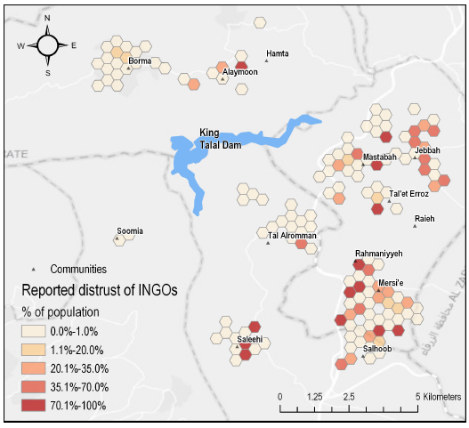
CFW Potential Challenges
Due to limited interactions, majority of households do not know if they trust NGO’s
Most community members are not against Syrians receiving CFW opportunities, but want Jordanians prioritized
CFW programmes should be cautiously managed to avoid deterioration in existing levels of tension
Notes:
Relations and interactions between Jordanian community members and Syrian refugees are good, albeit limited due to the relatively small population of Syrians and other nationalities. Despite this, nearly a quarter of the population purport to distrust Syrian refugees - mainly due to perceived competition over jobs and the presence of refugees causing prices to increase. This plays into community perceptions of CFW – while community members are not averse to Syrians being offered CFW opportunities, overall it is felt that such opportunities should be prioritised for Jordanians first, particularly as Syrians are perceived to receive more assistance from INGOs and local NGOs generally. As high unemployment and job competition is likely to continue to be a source of tension between Syrian refugees and host communities, CFW programmes should be cautiously managed to avoid any deterioration in existing levels of tension.

Slide 14
Tannour Dam

Slide 15
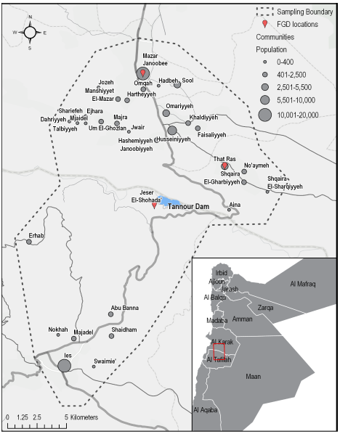
Tannour: Assessed Area
Notes:
All of this information based on the household survey. In total, 380 surveys were conducted with households around King Talal dam.
The majority of household heads in the communities around the dam are male-headed (84%) and married (86%).
Heads of households in the communities surrounding the dam are relatively well-educated, with the majority educated to secondary education level (55%) and 17% to a postgraduate level (see Figure 1 below). There are no significant differences in education attainment levels between male and female heads of household in the area.
According to KIIs and FGDs participants, there are over 45 tribes and sub-tribes in the King Talal dam area, dispersed throughout different communities, rather than being geographically concentrated together. The largest tribe is Bani Hasan (50%). According to FGD participants, Bani Hasan is also the wealthiest tribe due to their large number of livestock (a local indicator of wealth).
The majority of households in the King Talal Dam area have at least one male family member who is employed (84%).5 Of these, the majority (73%) rely on just one working member, while 27% have two or more working household members. The top three sectors of employment for male community members are the military (43%), other public sector employment (12%) and agriculture (10%) . Female employment is low (15% of HHs)
Access to livelihoods constitutes a main concern for households in the assessed area with 47% identifying livelihoods as a priority need, followed by public transport (18%), and education (17%).

Slide 16
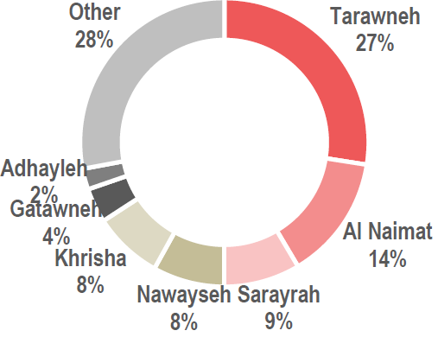
Demographics and socioeconomic background
97% of the population are Jordanian, with just 2% Syrian
80% have at least one employed male member, while only 22% of households have a working female member
Livelihoods are heavily reliant on the military, while only 3% of households have men working in agriculture
There are many different tribes in the Tannour Dam Area.
Notes:
The vast majority of the population in communities surrounding Tannour Dam are Jordanian (97%), with a smaller population of Syrian refugees (2.6%) and Egyptians (0.4%).
Households are generally settled within their communities, on average respondents having been in their current location for 29 years.
The majority of households in the Tannour Dam area have at least one male family member who is employed (83%).5 Of these, the majority (73%) rely on just one working male family member, while 26% have two or more working male family members. The top three sectors of employment for male community members are the military (46%), military pension (retired) (32%)6 or other public sector employment (17%)
The high reliance on the military for income reflects the low diversity of livelihood opportunities in the area. There are also few agricultural livelihood opportunities, with only 3% of households with employed male family members with men working in agriculture, and no households with women working in agriculture.
There are many different tribes in the Tannour Dam area, survey respondents reporting 62 different tribes. The largest tribes are Tarawneh (28%), Al Naimat (14%), Sarayrah (9%), Nawayseh (8%) and Khrisha (8%). There appear to be some differences between tribal communities. FGD participants from That Rass FGDs explained that the Ja’freh and Hawary sub-tribes are the largest, and have better levels of education than other tribes in the community. Furthermore the Hawary are perceived to be wealthier, with more members holding positions in the public sector, and owning more land.

Slide 17
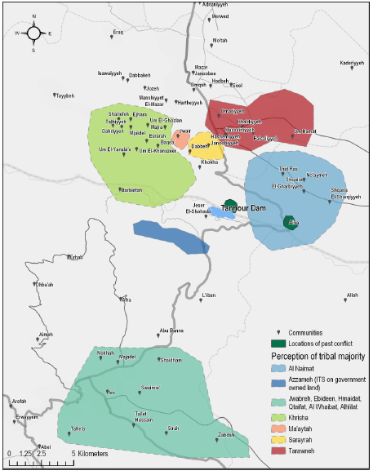
Key stakeholders
Arab Potash Company – the main beneficiary of the dam, conducts water desalination
Private land owners – Some land around the dam is privately owned, for agriculture. Most owners are from the Khrisha and Al Neimat tribes.
According to the household survey, local community members are most connected with and trustful of their tribal leaders.
FGD’s reported that there is some conflicts over land in the area, including land near the dam. The conflict is being mediated by tribal leaders and the Governor.
Notes:
FGD and KIIs unanimously identified the Arab Potash Company, which conducts water desalination operations, as the main beneficiary of Tannour Dam.
Farmers are allowed to use some of the water from the streams for irrigation, though it is forbidden to take water from the dam itself, and only people living near the dam can go to the area at all. The government appears to be the main land owner around the dam, as well as some private landowners, particularly the Khrisha tribe and around Afra, the Al Neimat tribe. Land use is mixed between livestock rearing as well as fruit and vegetable cultivation. Similarly, when asked who the largest land owners around the dam are, households identified government bodies (34%) and local communities (21%) as the largest landowners, though 32% did not know.
Another dispute reported by both Mazar Janoobee and That Rass FGD participants revolved around ownership of government land around the dam, and tribal influence over certain areas (refer to Map 2, area directly north of Tannour Dam). This conflict is reportedly being addressed by the mukhtar and the Mutasarref (mayor) as well as the Governor.

Slide 18
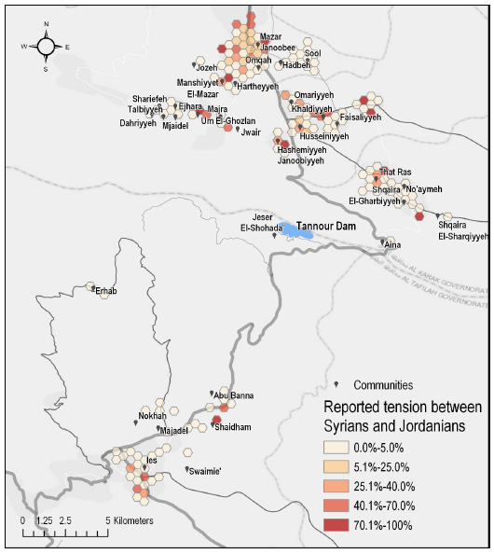
Community Dynamics
According to the household survey, most households rarely interact with Syrians, with only 34% interacting with Syrian refugees once a month.
Trust for Syrians is similar to the other areas surveyed, with 21% of respondents reporting the “distrust” or “very much” distrust Syrians, although 37% do not know.
Competition for jobs and assistance, as well as price inflation are once again the main drivers of tension
There are no current disputes around nationality
Notes:
general, individuals of other nationalities are distrusted less (15%) than Syrian refugees (21%), though the high proportion who ‘do not know’ reflects the relatively few non-Jordanians living in the assessed area (see Figure 8). For those reporting distrust of Syrian refugees, the main reason is competition for jobs (77%), the perception that Syrian refugees have caused prices to increase (74%), as well as competition over access to assistance (37%).
Jordanian FGD participants stressed the perception that Syrian refugees have access to humanitarian assistance while Jordanians do not. Despite this, 76% of households do not perceive there to be tension between Syrian refugees and Jordanians
there were no current disputes around nationality reported.

Slide 19
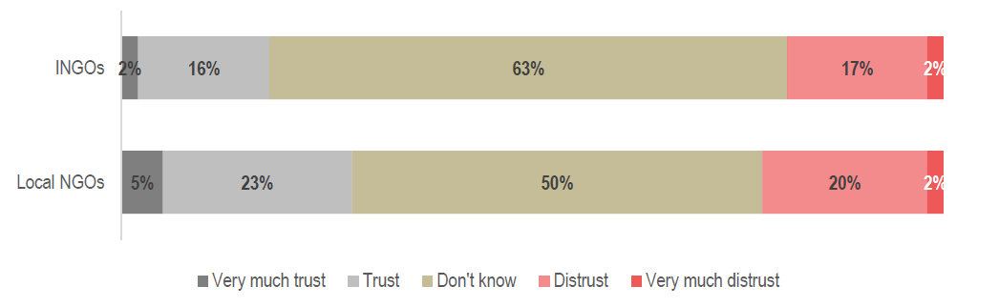
Community Dynamics
Households surveyed have very limited interaction with NGOs, particularly international organizations. Most answered that they did not know if they trusted NGOs.
Many FGD participants felt that the selection of beneficiaries was unfair, for example bussing Syrian refugees form outside the area for CFW.
The community felt that opportunities should be prioritized for Jordanians first.
Cash for work programmes may need to be sensitive to prevent increasing tension
Notes:
Households have very limited interaction with NGOs, particularly international organisations. In total, 12% of households report to interact with local NGOs at least once every six months, and only 4% interact with international NGOs at least once every six months.
As such, the majority of households do not know if they trust these organisations (63% for INGOs and 50% for local NGOs)
FGD Participants from the ITS were more distrustful, and had a negative perception of NGOs reaching out to them for meetings, information and photos but then providing no assistance. They also felt the selection of beneficiaries was unfair, for example bussing Syrian refugees from outside the area for CFW opportunities.
While community members are not averse to Syrians being offered CFW opportunities, overall it is felt that such opportunities should be prioritised for Jordanians first, particularly as Syrians are perceived to receive more assistance from INGOs and local NGOs. As high unemployment and job competition is likely to continue to be a source of tension between Syrian refugees and host communities, CFW programmes should be cautiously managed to avoid any deterioration in existing levels of tension.

Slide 20
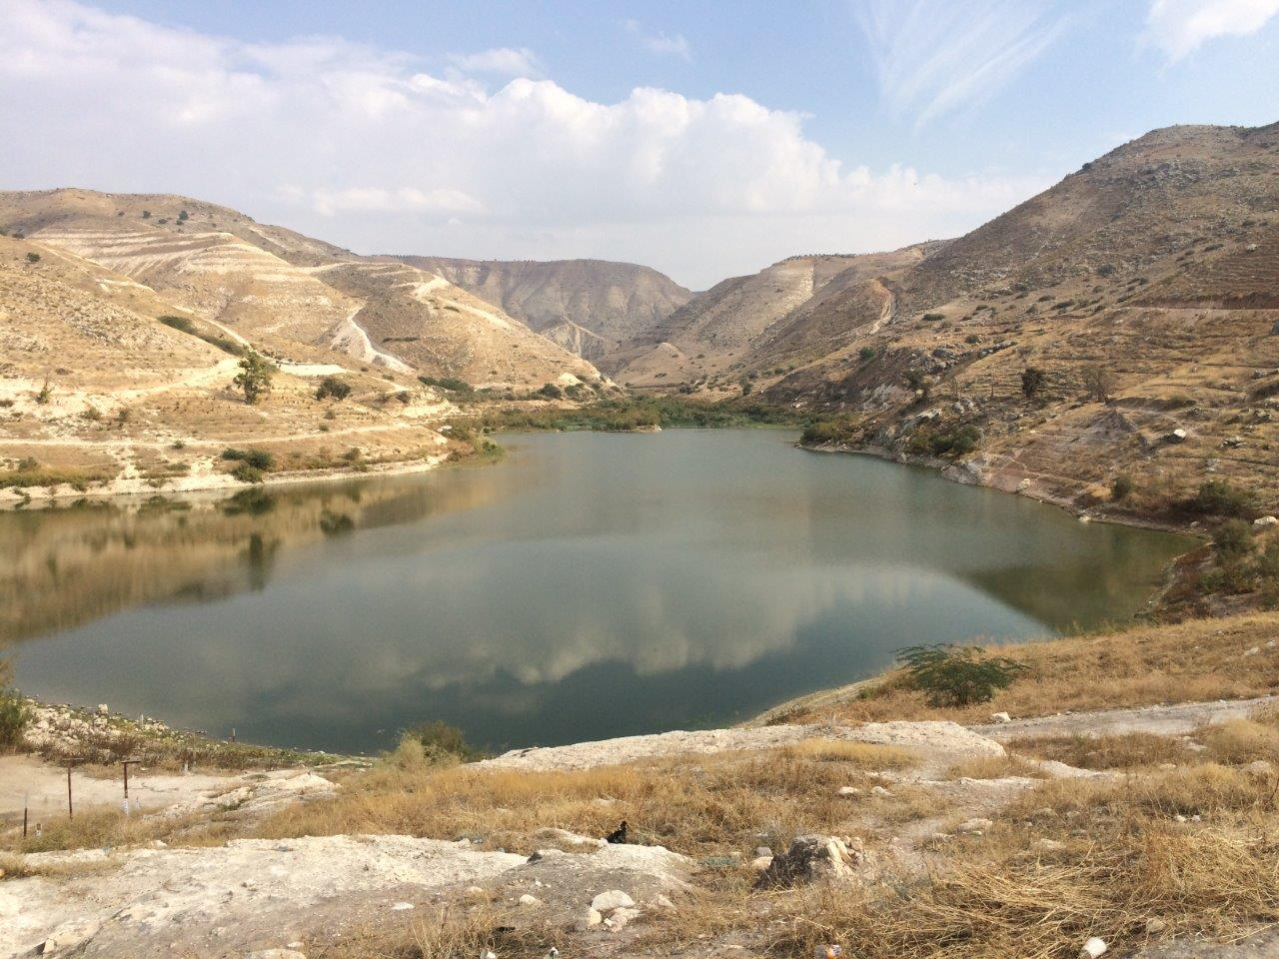
2
Zeglab Dam
Zeglab Dam

Slide 21
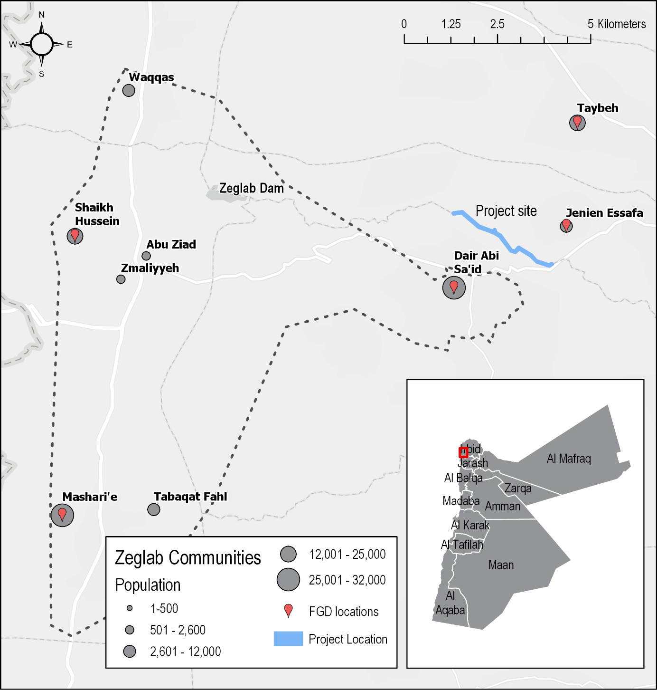
Zeglab: Assessed area

Slide 22
Demographics and socioeconomic background
97% of the population are Jordanian, with just 2% Syrian
Over 130 tribes in area, with 6 main tribes. The Al Ghzawi tribe perceived to be the biggest land owners.
Main livelihoods are in the military, agriculture and public sector employment
80% have at least one employed male member, only 9% of households have a working female member
Livelihoods is key household priority identified (57%)
Tribe | Percent
Bani Mrra | 18%
Alzubi | 14%
Alshraydeh | 10%
Alraba’ | 8%
Bani Eid | 6%
Bani Rshed | 5%

Slide 23
Key Stakeholders around Zeglab Dam
Government - KIIs reported that the land directly surrounding the dam is owned by the Jordan Valley Authority and Ministry of Water and Irrigation. Outside of that, there is a buffer of land around the JVA owned land that was gifted to Friend's Land Association by the JVA (a total of 100 donum). From the HH survey, 23% reported that the government owns land around the dam.
Local community territory – KIIs and FGDs reported main land owning tribes are - Al Ghazawi (also the largest tribe in terms of population size), Alabtat and Alqallat tribes (own lands behind the dam).
Local farmers – Outside of the direct proximity of the land, FGDs and KIIs reported that land is primarily privately owned and used for livestock and agriculture.
The majority of farmers do not use water from Zeglab dam, but instead from Wadi Arab dam because the water from Zeglab dam is reserved for "important people" not living in the area.
KIIs explained there is no conflict around land ownership, primarily because it is privately owned and people know what who owns what land.

Slide 24
Community Dynamics
Households interact most frequently with tribal leaders, more commonly through personal visits/relations than formal meetings.
The community actors the community trust the most are the police (92%) and tribal leaders (88%).
Households in Dair Abi Sa’id interact with Syrian refugees much more frequently than households in the western communities:

Slide 25
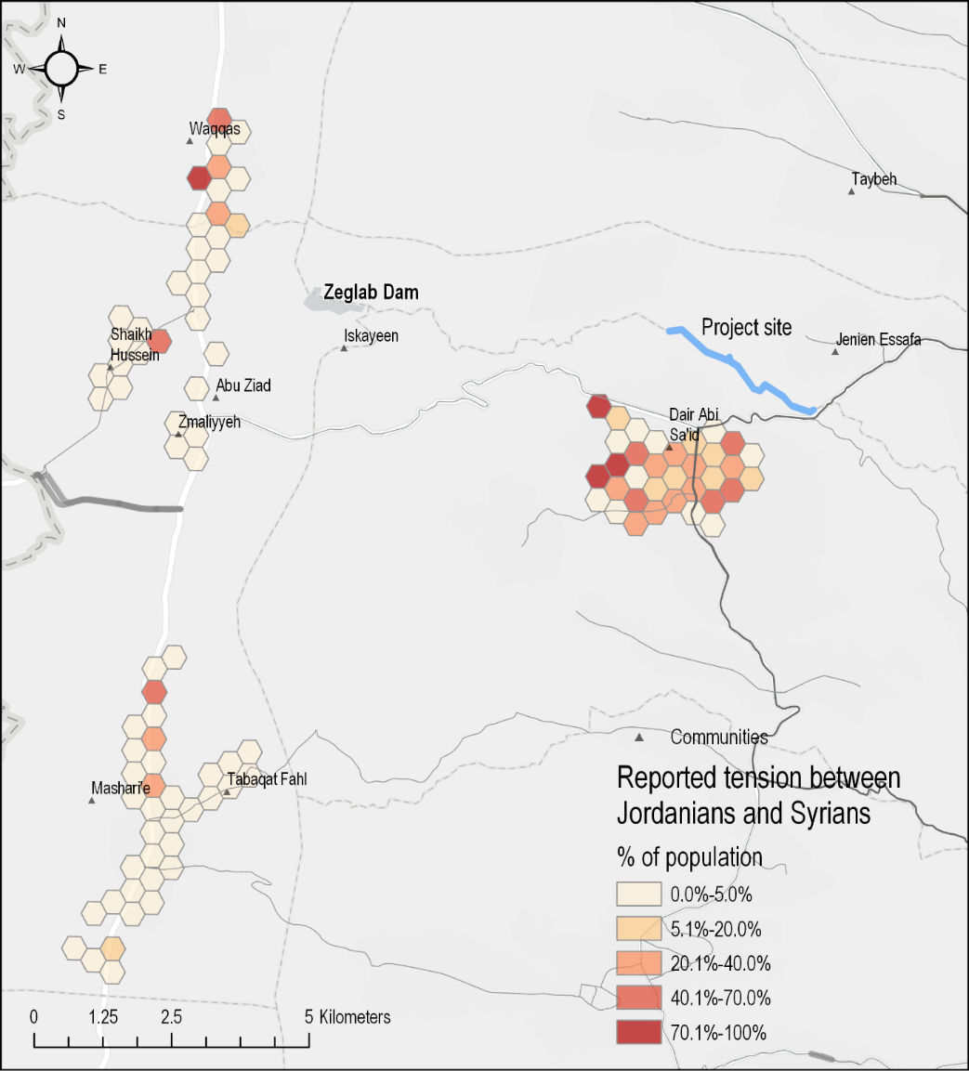
Community Dynamics
Households in Dair Abi Sa’id also distrust Syrian refugees (27%) much more frequently than households in the western communities (10%) and perceive there to be more tension.
Main reasons for tension are competition over jobs, increase in prices and access to assistance.
Households are most likely to turn to tribal leaders to resolve disputes.
Very little interaction with NGOs – only 10% aware of any NGO presence in their community.

Slide 26
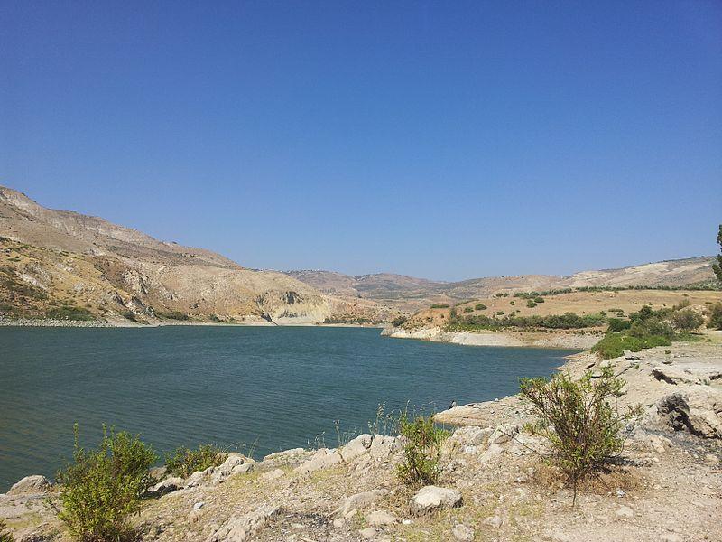
2
Wadi Al Arab Dam
Zeglab Dam

Slide 27
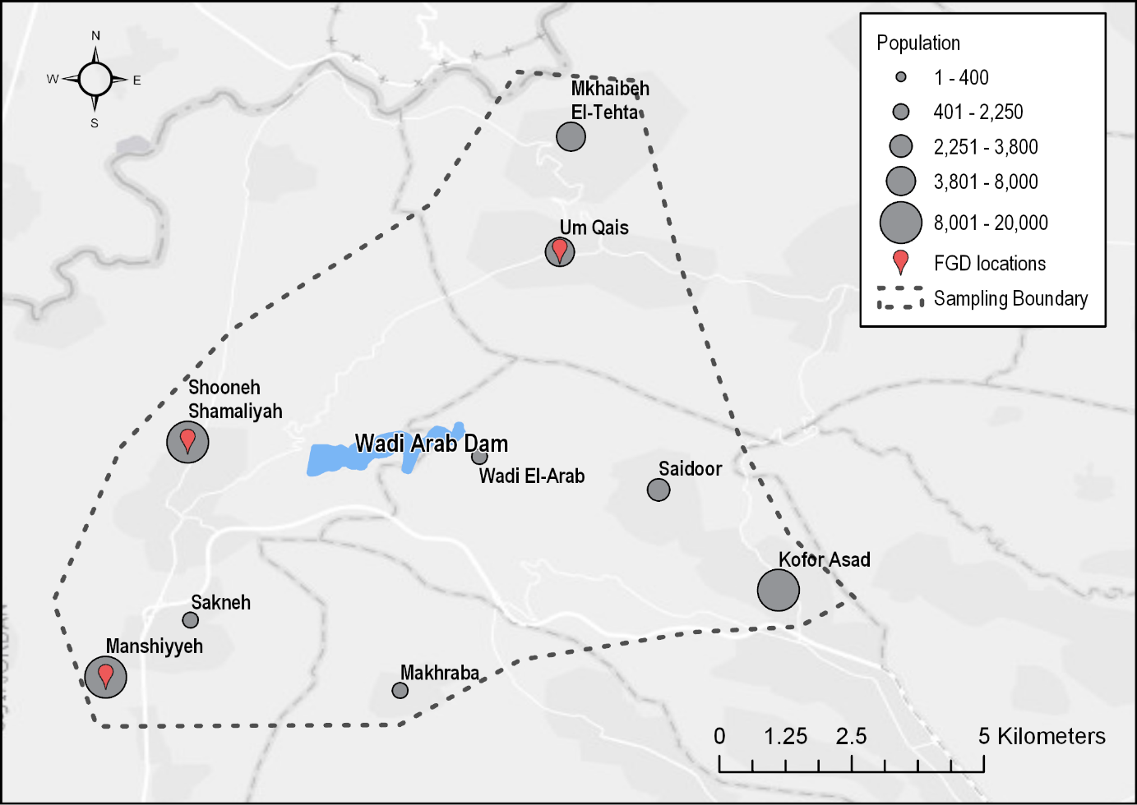
Wadi Al Arab: Assessed area
Notes:
A total of 383 household surveys were conducted in the target area to achieve results which are generalisable to the sample area population with a 95% confidence level and 5% margin of error.
3 KIIs and 6 FGDs

Slide 28
Demographics and socioeconomic background
97% of the population are Jordanian, with just 2% Syrian
Over 116 tribes in the area. The Al Bishtawi, AlHourani, Shamali, Alkhawaldeh, Rossan and Aaomari referenced in FGDs as being influential.
Main livelihoods are in the military, agriculture and public sector employment
84% have at least one employed male member, 15% of households have a working female member
Livelihoods is key household priority identified (51%)
Tribe | Percent
Bashtawi | 7.5%
Alomari | 4.8%
Alamaireh | 4.3%
Azzam | 4.3%
Delki | 3.5%
Malkawi | 3.0%
Telawi | 3.0%
Almhiedat | 2.7%
Almeshreqi | 2.4%
Majadlah | 2.2%

Slide 29
Key Stakeholders around Zeglab Dam
Families and tribes that own the land: Examples of tribes include Almhiedat, Bishtaweea and Alomari.
Farmers and shepherds: All farmers to the west of the Dam reportedly rely on water from the Dam for agricultural purposes. This includes farmers from Shooneh Shamaliyah to Waqqas (including Sakneh, Manshiyyeh, Majed, Feddein in the middle). As the land near the Dam is mountainous, it is primarily used for livestock grazing with little agricultural use. The land surrounding the Dam includes both private and government farms.
Fishermen: Rely on fishing from the Dam for livelihoods.
Ministry of Water and Irrigation / Water Authority of the Jordan Valley: Responsible for pulling water from the Dam, purifying the water, and piping it to Irbid and Amman. The Ministry is also responsible for allocating certain quantities of water to farmers for irrigation purposes
Ministry of Agriculture
Municipalities: This includes municipalities of Um Qais, Khofor Assa and Moadh Bin Jabal, which provides public services such as street cleaning, street lights, financial aid and recycling services
Dam workers
Water User Association: Responsible for management of water distribution of water for each plot of farm in the Jordan Valley

Slide 30
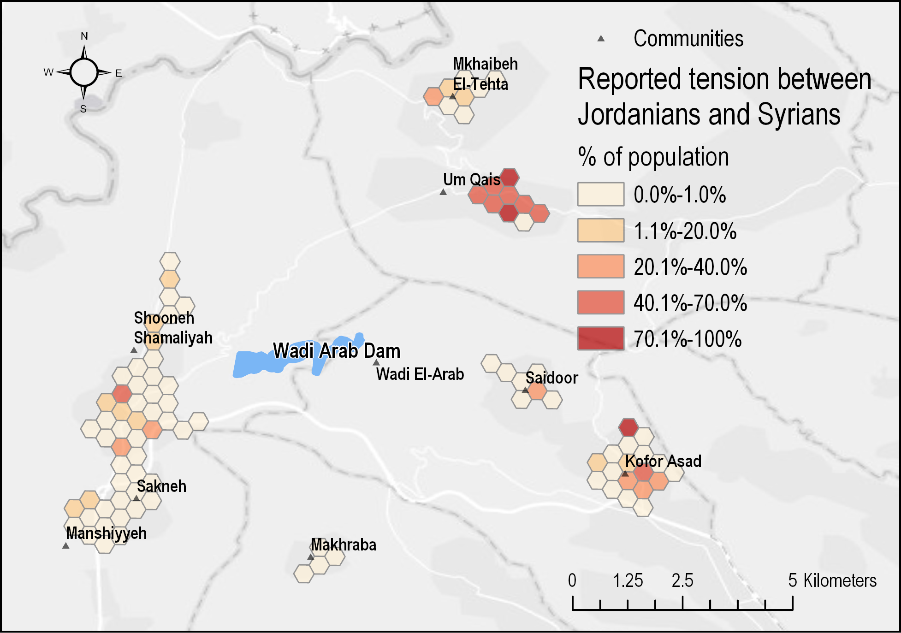
Community Dynamics
Households interact most frequently with religious leaders and tribal leaders. There is a higher degree of trust in those leaders, less trust in the mayor, municipal council members and the governor.
A majority of households had never interacted with Syrians (68%) reflecting the low Syrian population in the Jordan Valley area.
17% of respondents reported tensions and to distrust Syrians, and this was higher in Um Qais than other areas.

Slide 31
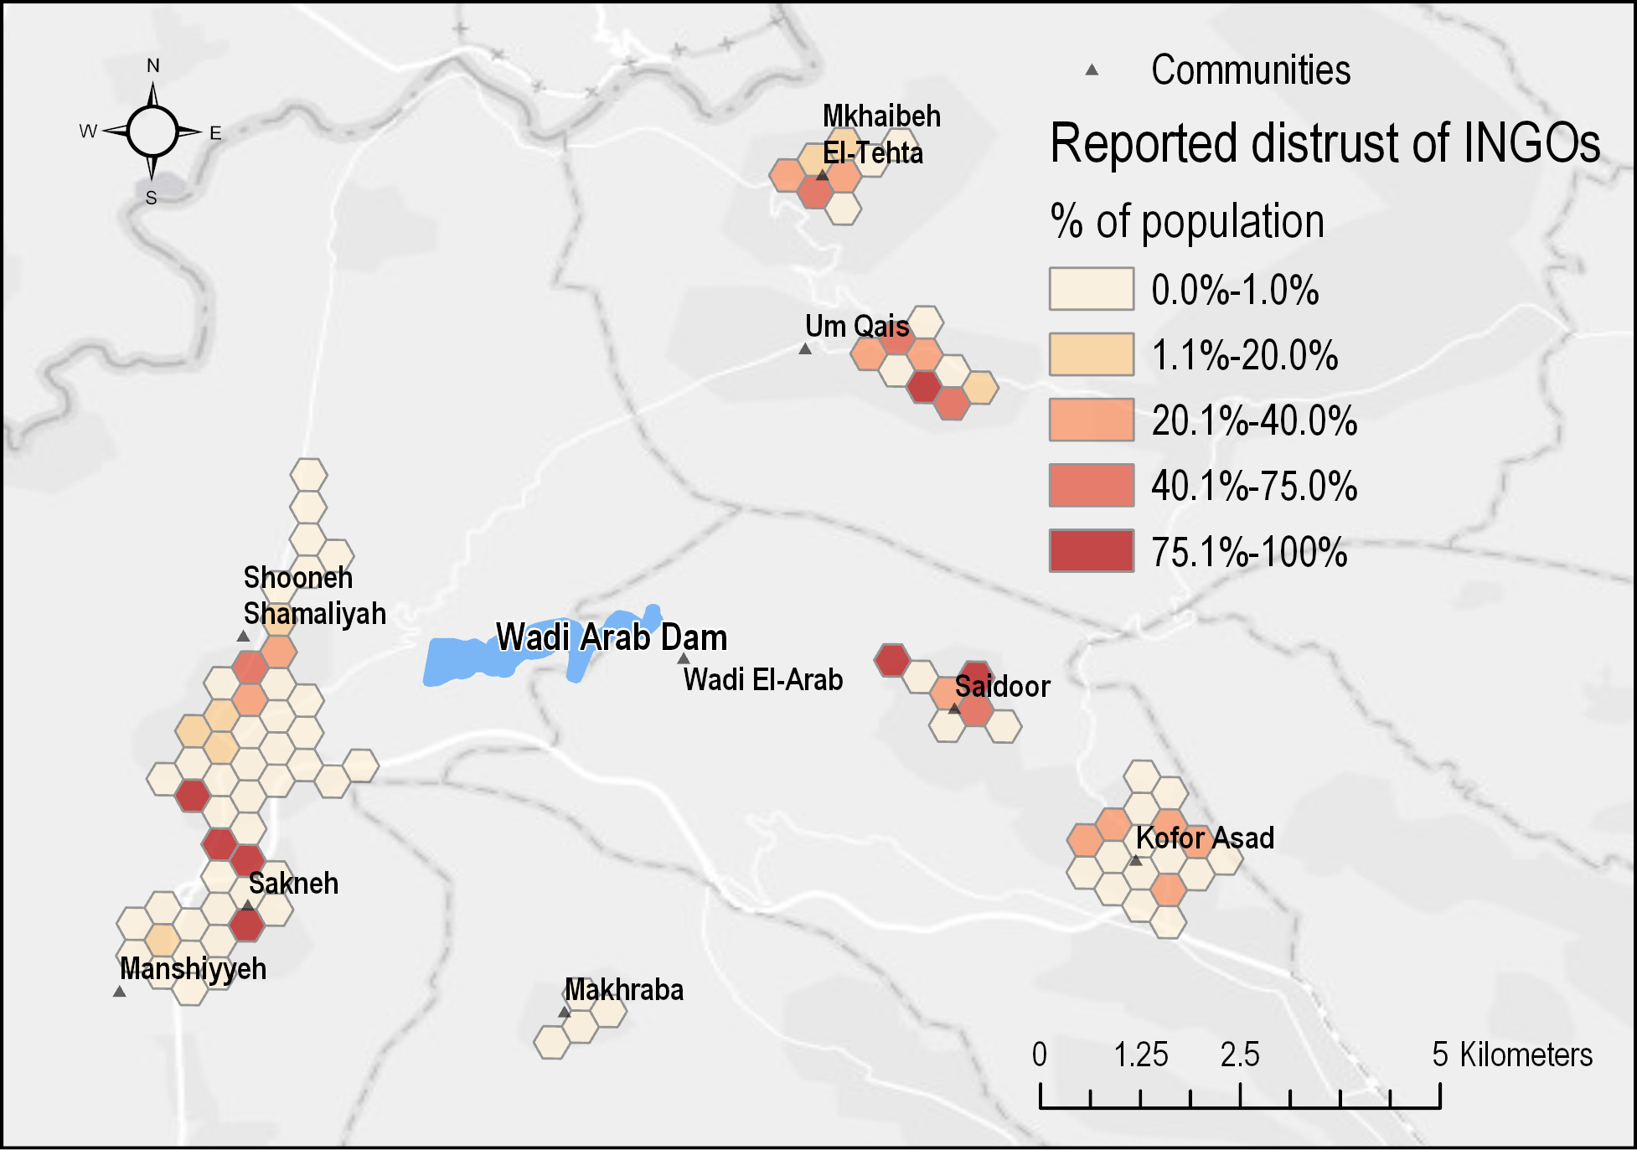
Community Dynamics
Some interaction with NGOs – only 24% aware of NGO presence in their community, though only 7% have interaction with NGOs at least once every six months.
Majority of respondents do not know whether they trust NGOs – though this was higher in Um Qais

Slide 32
CONCLUSIONS
Studies did not find any serious underlying tribal or community tensions around the dams.
Tribal leaders play key roles in the community, with high levels of interaction and a clear role in dispute resolution.
Livelihoods and high unemployment rates remain key concerns in communities.
Perceptions of CFW are positive, though limited interaction with INGOs affects the level of trust. Important to manage expectations and to prioritise local communities where intervention is taking place
Small Syrian population though some cases of distrust and tension, mainly due to competition over livelihoods

